Slide 1
SOA – DDD Transformation
A Coding Kata to train the DDD mindset

Slide 2
Discover
Gain an understanding of the domain(s)

Slide 3
Job to be done - Shop
Browse a catalog
Add items to the order
Place the order
Maybe cancel the order

Slide 4
Discover – Domain Model
Build a model

Slide 5
Analyze Implementation Model
Build a model

Slide 6
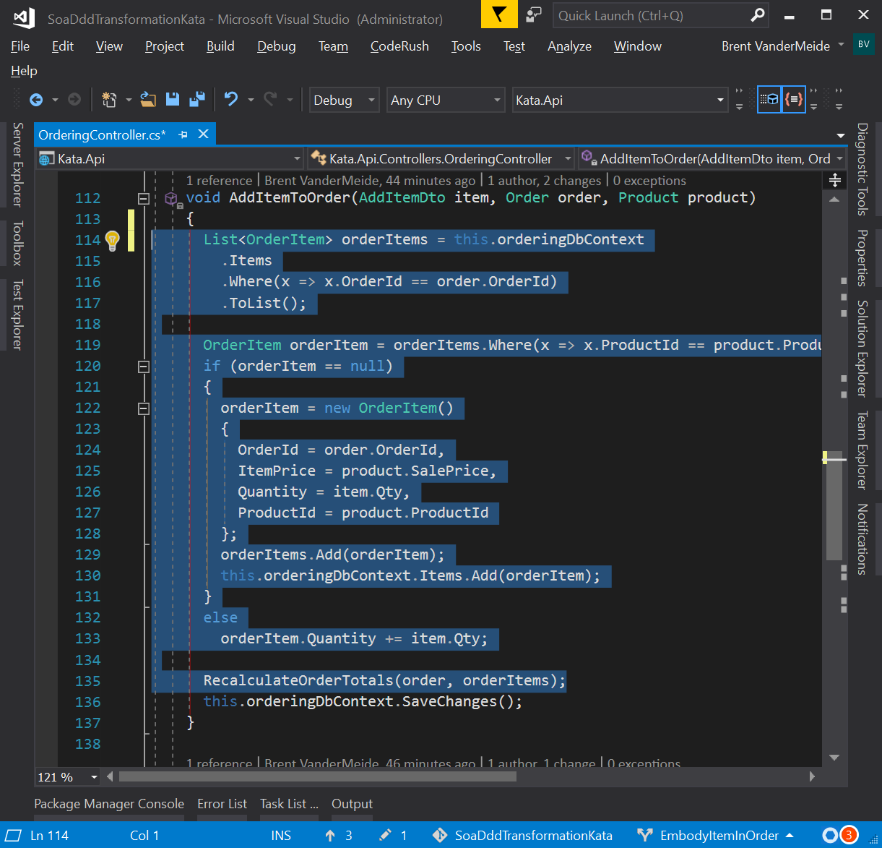
Let’s Encapsulate
Entities are being mistreated as anemic

Slide 7
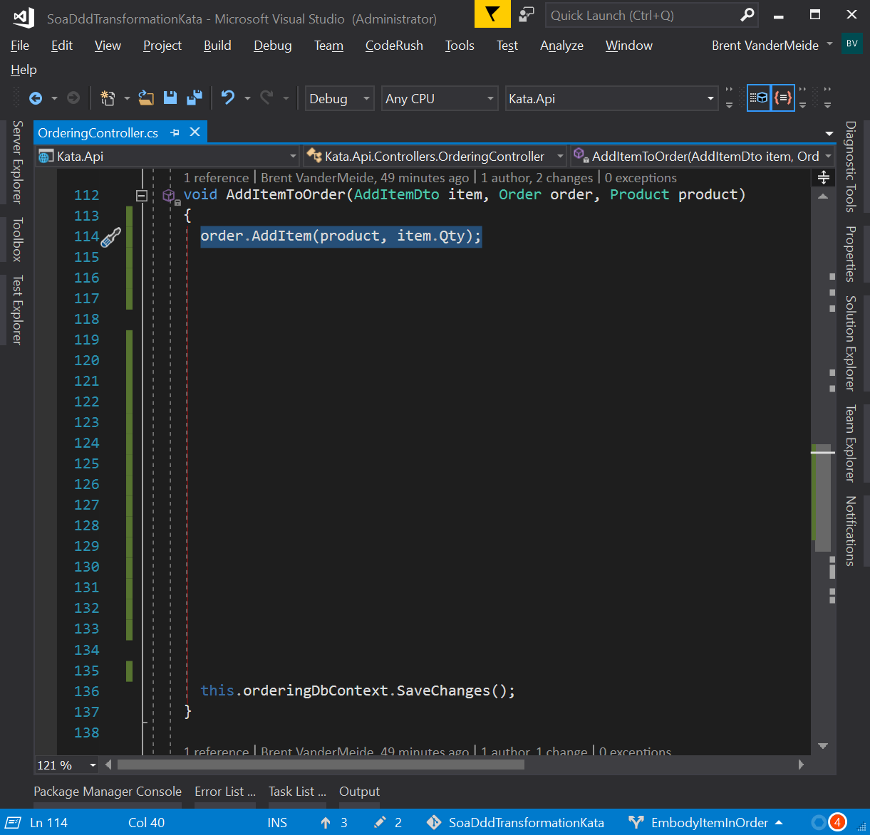
Let’s Encapsulate
Entities should be treated as rich

Slide 8
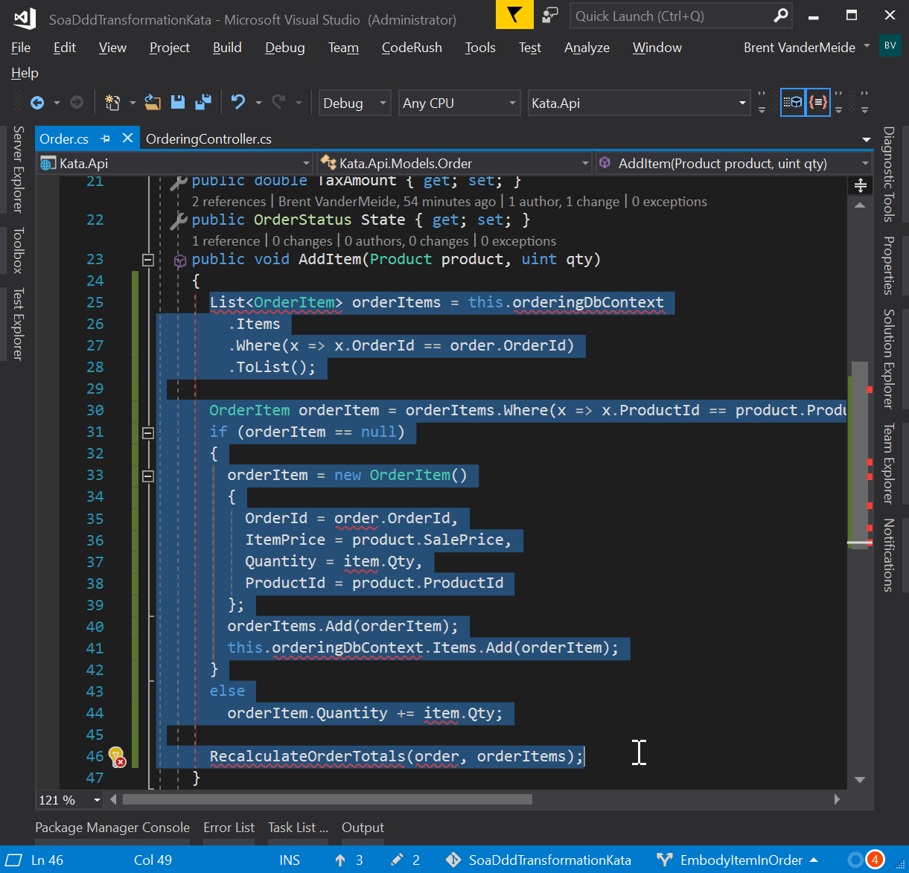
Let’s Encapsulate
Entities should be treated as rich Move logic into Order entity

Slide 9
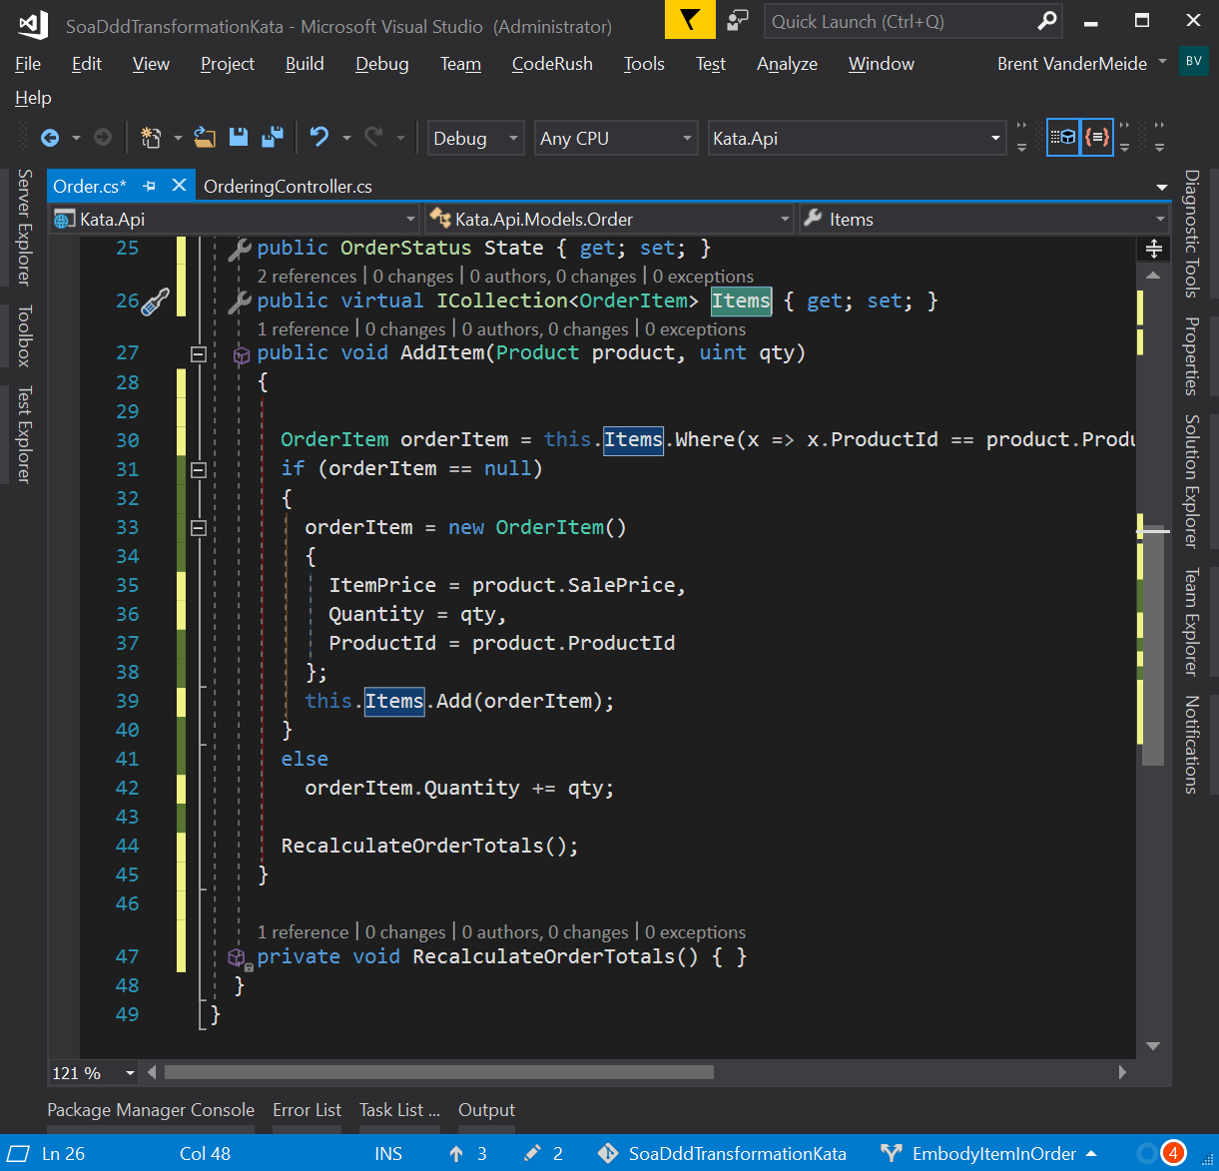
Let’s Encapsulate
Entities should be treated as rich add Items collection and refactor AddItem method stub RecalculateOrderTotals

Slide 10
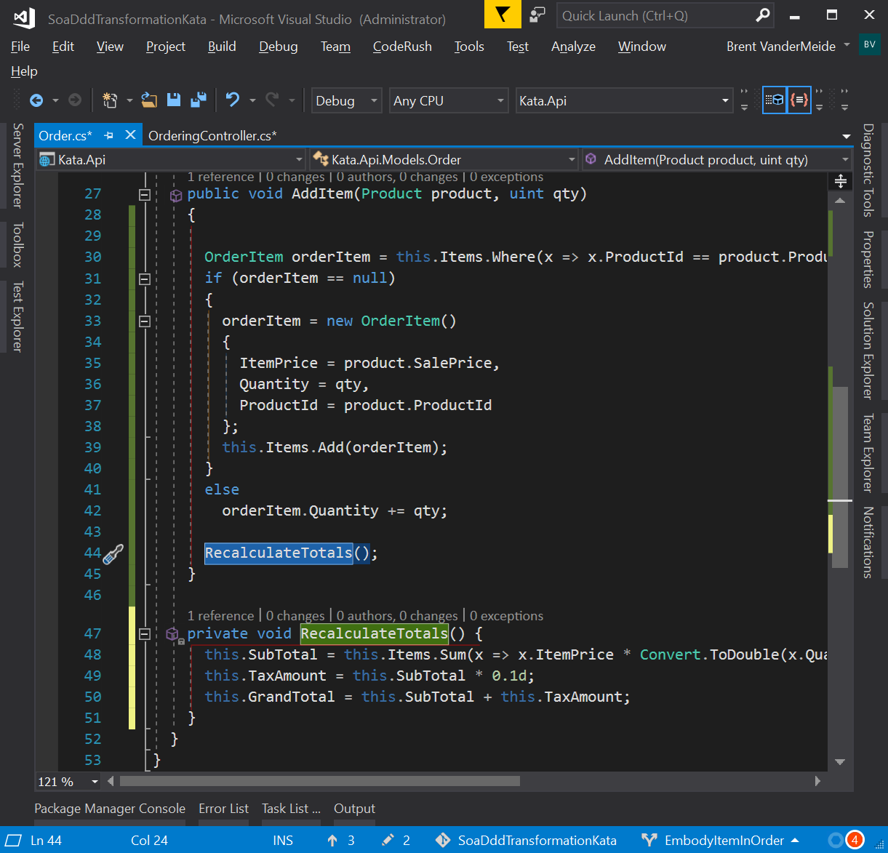
Let’s Encapsulate
Entities should be treated as rich rename & port RecalculateTotals logic

Slide 11
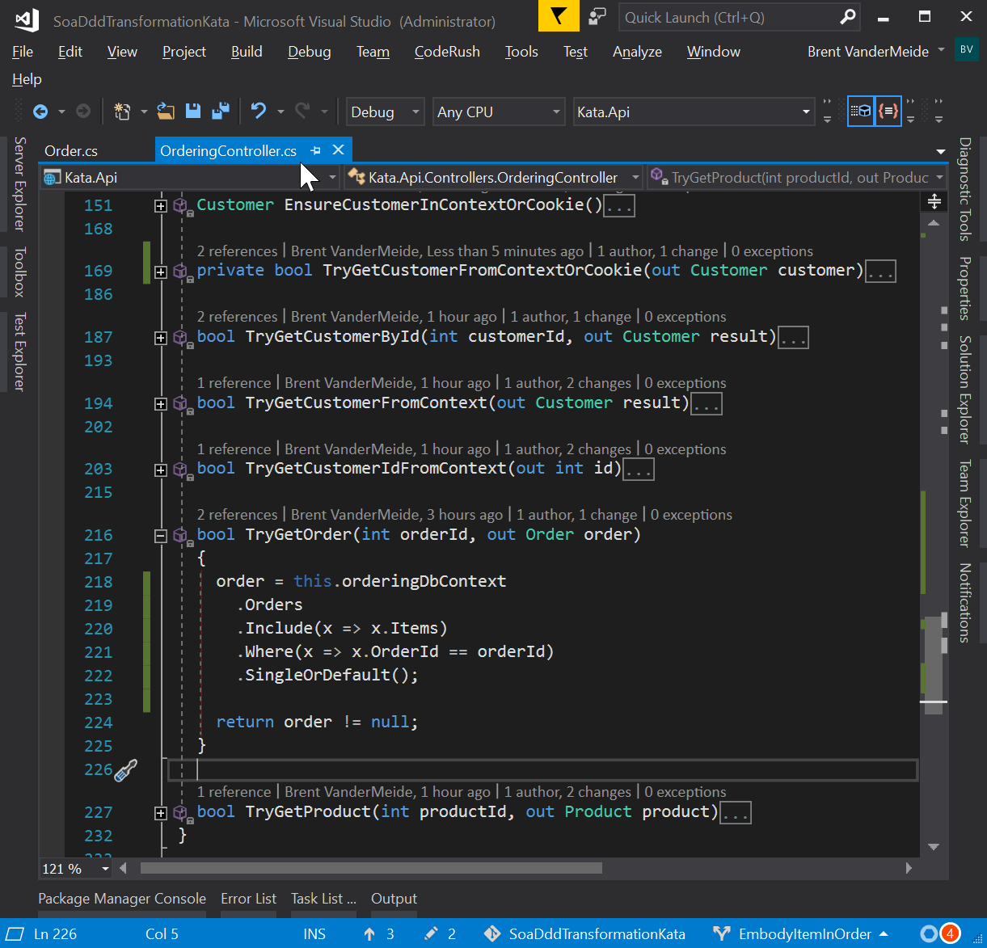
Let’s Encapsulate
Entities should be treated as rich load entire order entity when loading an order

